Slide 1
Sleep Monitering System
Team I Members:
Name | Roll No. | PRN No. | Branch
Anushka Bhagwat | 224001 | 22110043 | C.S
Aneesh Kulkarni | 224033 | 22110220 | C.S
Amey Kottawar | 213023 | 22110236 | ENTC
Himanshu Chaudhari | 231014 | 22110377 | IT

Slide 2
INTRODUCTION:
Nowdays getting good quality sleep is important for every person to get better physical health.
So the department of internet of things(IOT) technology supports to build a consistent and cost effective system to monitor the sleep quality of persons.
This system is effective enough that it can proficiently monitor patient’s sleep using commercial off the shelf (COS) sensors as well as predicts results using intelligent capability.
From this system we can easily measure the sleep patterns of patients and can give cost effective system.

Slide 3
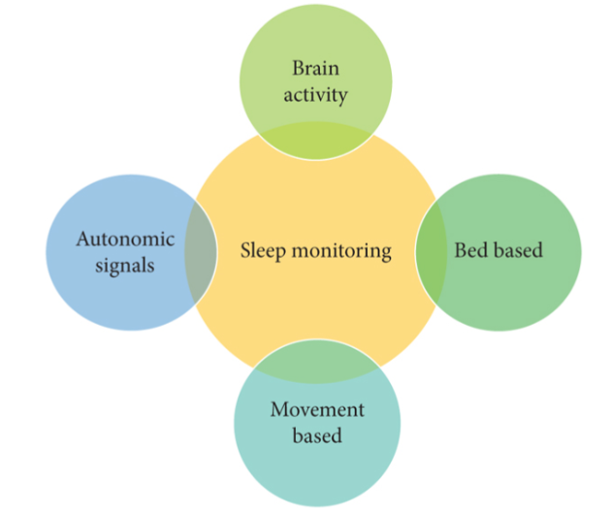
Objectives:
Use sensors to collect data.
Analyse the data using random forest algorithm.
Classify the sleep into categories.
Work Plan:
Research on the topic
Finalise research papers for reference
Learn about sensors.
Study random forest algorithm.
Define parameters to categorise sleep.
Compare sensors and choose one that best suits.
Formulate the budget.
Learn Arduino mega.
Implementation of random forest method.
Prototype building.

Slide 4
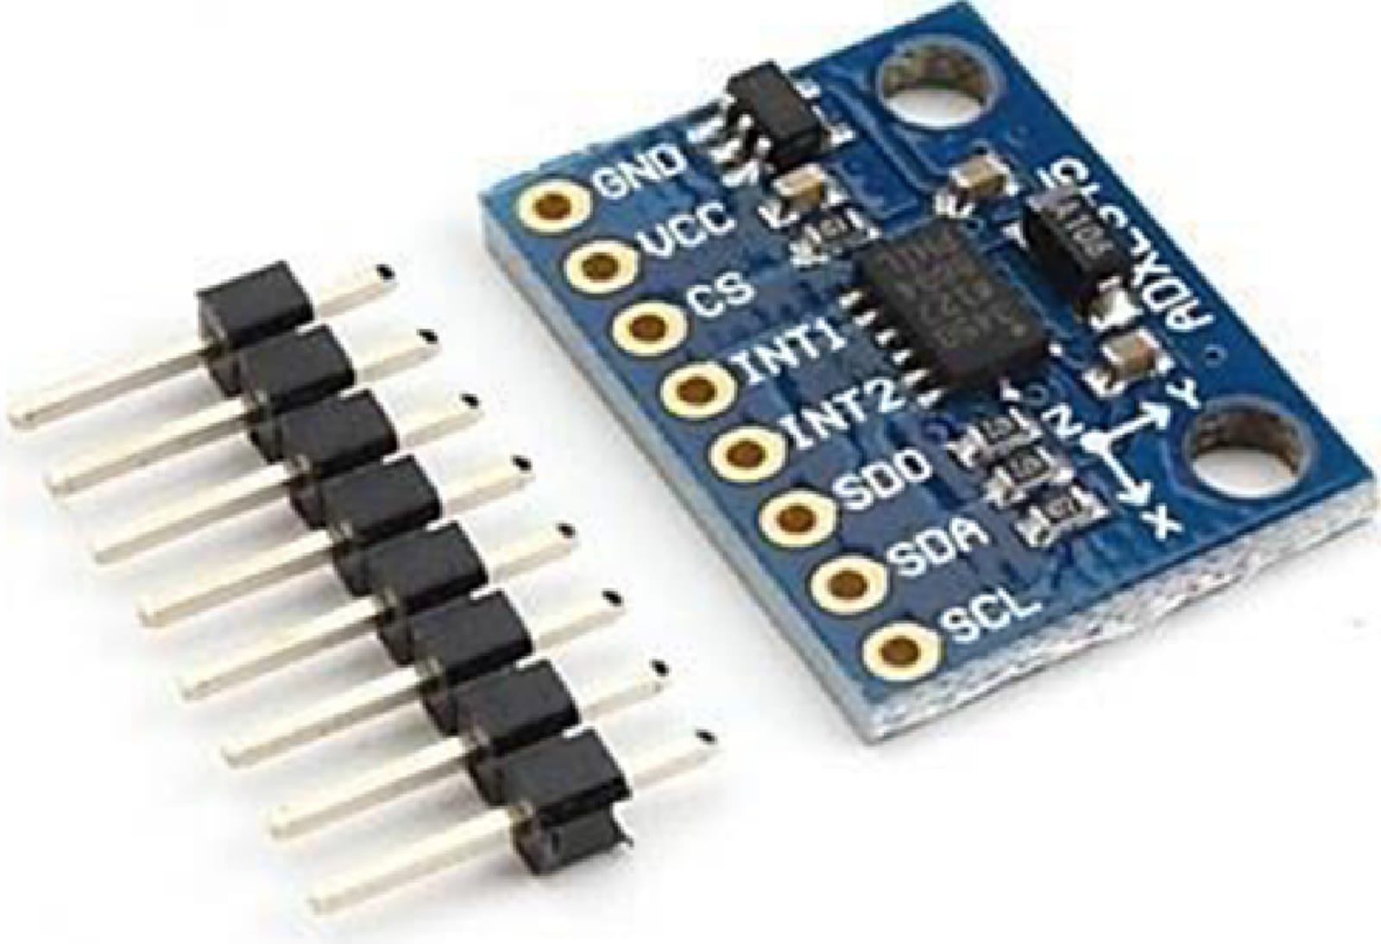
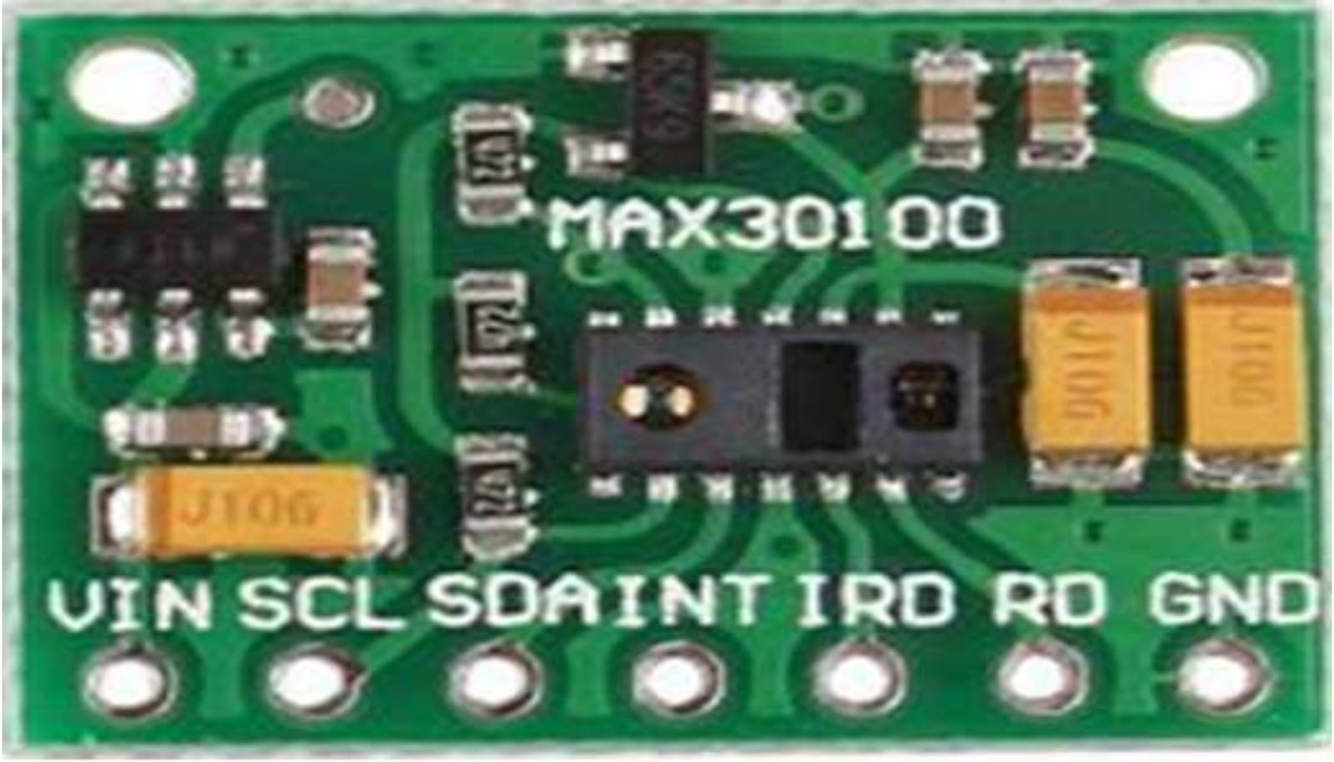
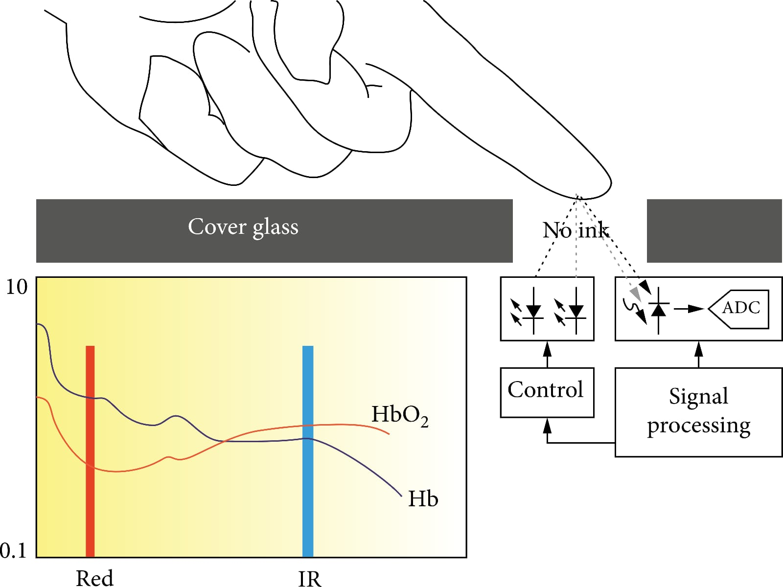
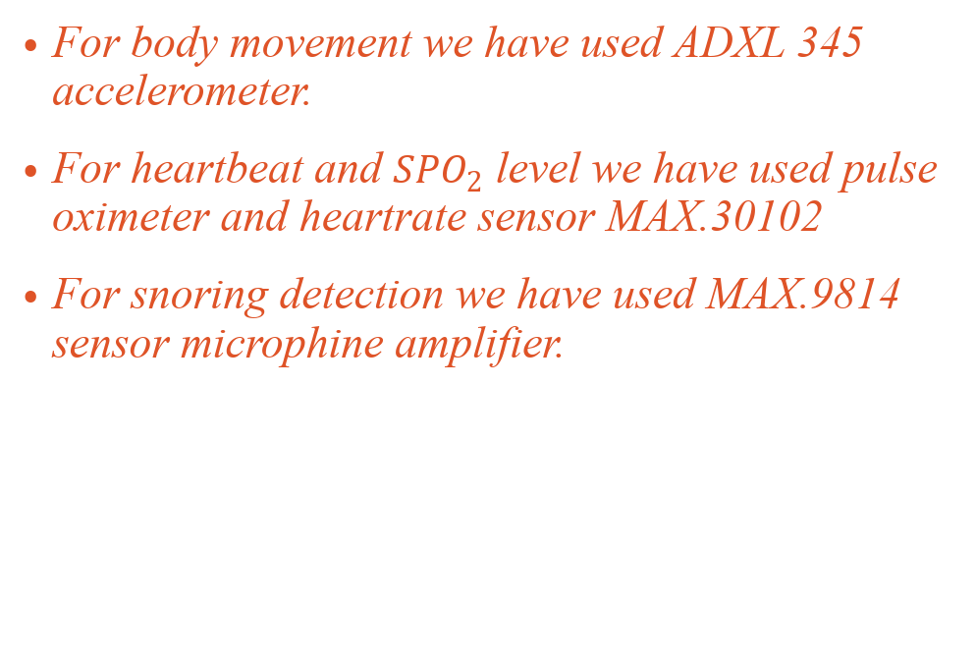
Hardware used :
For body movement we have used ADXL 345 accelerometer.
For heartbeat and ${SPO}_{2}$ level we have used pulse oximeter and heartrate sensor MAX.30102
For snoring detection we have used MAX.9814 sensor microphine amplifier.

Slide 5
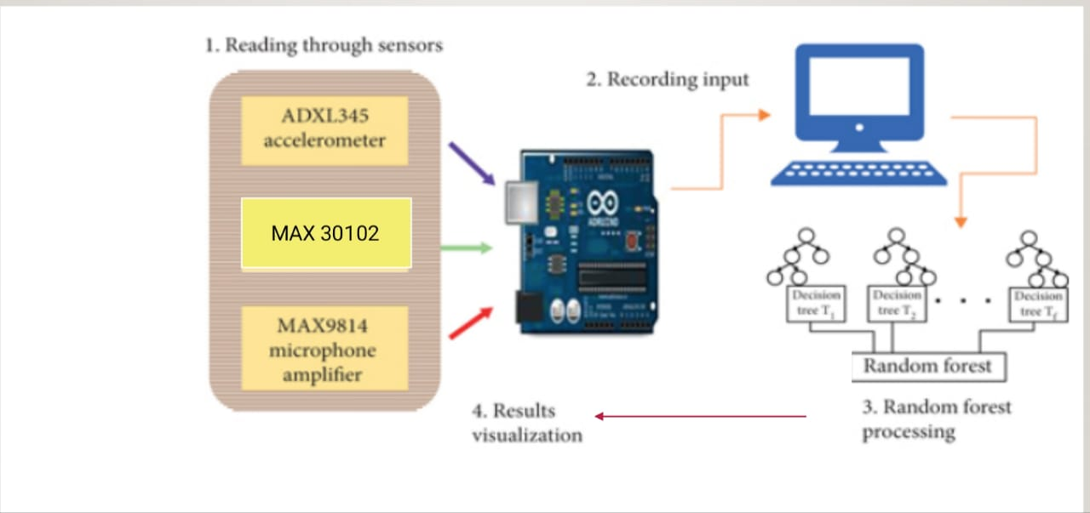
CIRCUIT DIAGRAM:

Slide 6
Prototype:
We have connected the
1.Microphone amplifier sensor to the color of the shirt . This is to record the snoring sound without with more accuracy
2.Pulse oximeter sensor to left arm to record SPO2 reading , body temperature and pulse count .
3.Accelerometer to right arm to note the movements of the body

Slide 7
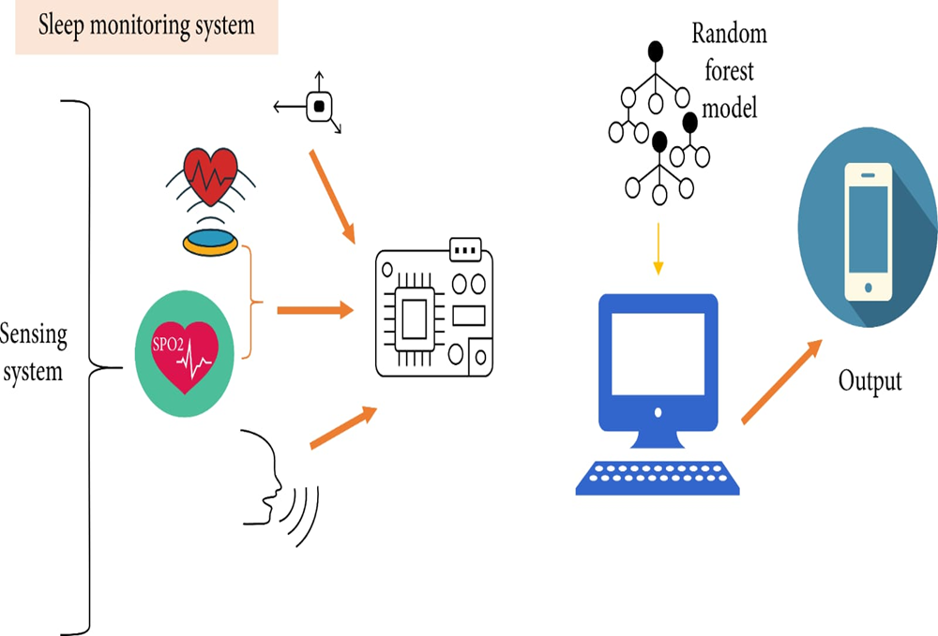
Design of Proposed System:
Data of patients recorded from sensors, sent to computer.
Random forest
Data classified to four categories-
Deep sleep
Light sleep
Rapid eye movement
Restless sleep.
Three steps-
Transfer of data from sensors to Arduino microcontroller
Storing data in file and then using it for training and testing of classifier
Collecting patient’s data and analyzing the sleep quality

Slide 8
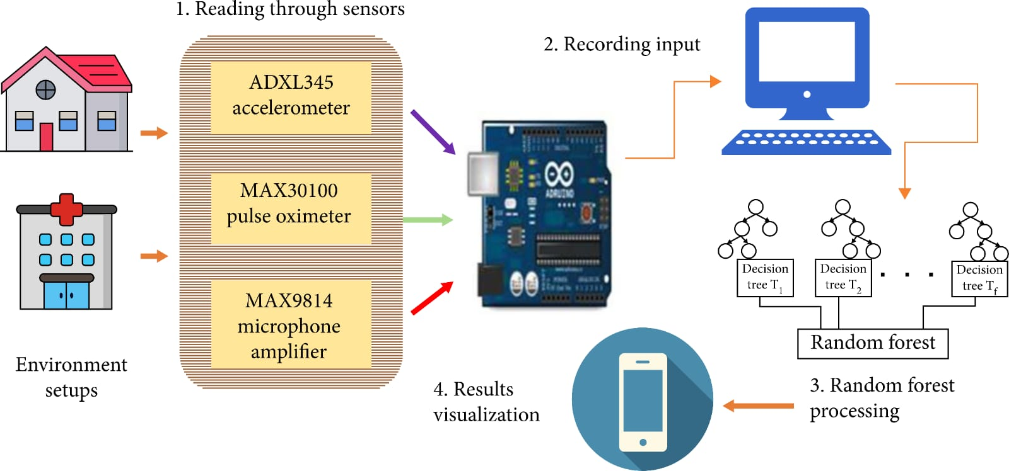
Implementation Details:
This system contains aurdino mega controller (2560) as a central microcontroller .
This controller takes real time records from sensors and forwards them to random forest model in computer system.
This is based on Main computer that is attached to microcontroller.

Slide 9
Machine learning model:
Step 1 :- Importing CSV dataset file using pandas
Step 2 :- Plotting the dataset using matplotlib
Step 3 :- Encoding the dataset
Step 4 :Splitting the Dataset Set into Training and Testing Sets ( using SK learn )
Step 5 : Training the model using training set
Step 6 : Testing the model using testing set
Step 7 : Check the accuracy of the model
Step 8 : Improve the model

Slide 10
FUTURE SCOPE:
(i)A portable patient’s sleep quality monitoring system can be proposed through wireless sensors and microcontrollers
(ii)Raspberry Pie can be used in the replacement of Arduino for the independent working of the system, in which results could be shown on a mobile app
CONCLUSION:
The proposed system sensed the patient’s sleep patterns using different sensors, which are cheap and easy to use. These sensors include an accelerometer, a pulse oximeter, and a microphone amplifier. This data transmitted through Arduino to the server for analysis and results with great effects and a small cost. These sensors were operated through the microcontroller. The heartbeat is calculated by placing the finger on it. These recorded values are stored in a computer system. Moreover, the results were shown on the computer screen.

Slide 11
References:
https://www.hindawi.com/journals/js/2020/8882378/
https://www.ieeespmb.org/2019/papers/l01_01.pdf

